Slide 1
Neurobiology Journal Club
Presented by: James Goodman

Slide 2
Introduction

Slide 3
Reach-to-grasp behavior: distinct phases
Reach-to-grasp: show the distinct phases, kinematically
Rouse & Schieber 2018 Cell Reports

Slide 4
Coupling between arm and hand
Reach-to-grasp: show kinematic coupling of arm & hand
Rouse & Schieber 2018 Cell Reports

Slide 5
Control of reach-to-grasp: distinct pathways
Reach-to-grasp: show the segregated reach- and grasp-pathways
Include the putative somatotopy in M1
Rouse & Schieber 2018 Cell Reports

Slide 6
Mixed information along these pathways
Reach-to-grasp: show the amount of overlap (at the single-neuronal level) at multiple stages of the movement planning-to-execution hierarchy:
Lehmann et al. 2013
Takahashi et al. 2017
Rouse & Schieber 2018 Cell Reports

Slide 7
Mixed information in M1
Reach-to-grasp: show the amount of overlap (at the single-neuronal level) at multiple stages of the movement planning-to-execution hierarchy:
Schieber’s monkey wrench in M1 somatotopy
Rouse & Schieber 2016
Rouse & Schieber 2018 Cell Reports

Slide 8
What, then, separates reach & grasp?
Could there be a distinction at the population level?
If so, what might the nature of this distinction be?
Object-vs-location dichotomy?
Early-vs-late dichotomy?
No dichotomy at all?
What fraction of activity is location-, object-, or even task-modulated?
Rouse & Schieber 2018 Cell Reports

Slide 9
Methods

Slide 10
Experiment
Mollazadeh et al. 2011 J Neurosci.

Slide 11
Experiment
Mollazadeh et al. 2011 J Neurosci.

Slide 12
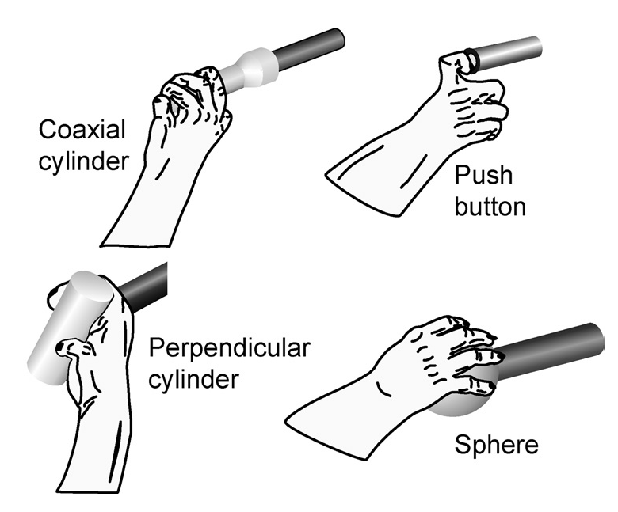
Experiment
Mollazadeh et al. 2011 J Neurosci.

Slide 13
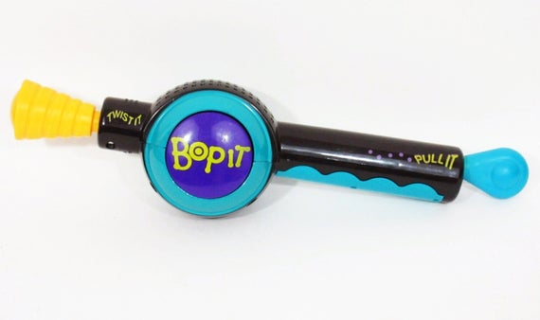
Monkey “Bop-It”

Slide 14
Trial Structure
Mollazadeh et al. 2011 J Neurosci.
Rouse & Schieber 2015 J Neurosci.

Slide 15
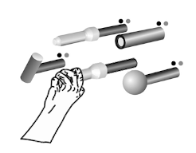
Trial Structure
Pull & Hold
T = 0
Mollazadeh et al. 2011 J Neurosci.
Rouse & Schieber 2015 J Neurosci.

Slide 16
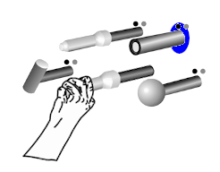
Trial Structure
Pull & Hold
T = 0
1500 – 2000 ms
Hold
Mollazadeh et al. 2011 J Neurosci.
Rouse & Schieber 2015 J Neurosci.

Slide 17
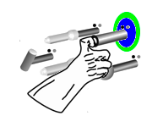
Trial Structure
Pull & Hold
T = 0
1500 – 2000 ms
Hold
Press & Hold
230 – 330 ms
Mollazadeh et al. 2011 J Neurosci.
Rouse & Schieber 2015 J Neurosci.

Slide 18

Trial Structure
Pull & Hold
T = 0
1500 – 2000 ms
Hold
Press & Hold
Hold
230 – 330 ms
1000 ms
Mollazadeh et al. 2011 J Neurosci.
Rouse & Schieber 2015 J Neurosci.

Slide 19
Trial Structure
Pull & Hold
T = 0
1500 – 2000 ms
Hold
Press & Hold
Hold
230 – 330 ms
1000 ms
Mollazadeh et al. 2011 J Neurosci.
Rouse & Schieber 2015 J Neurosci.

Slide 20
FMA Neural Recordings
Monkey L
Monkey X
Rouse & Schieber 2016 J Neurosci.
Notes:
300+ units per monkey
Pooled across sessions
SPS = superior precentral sulcus

Slide 21
Analysis & Results

Slide 22
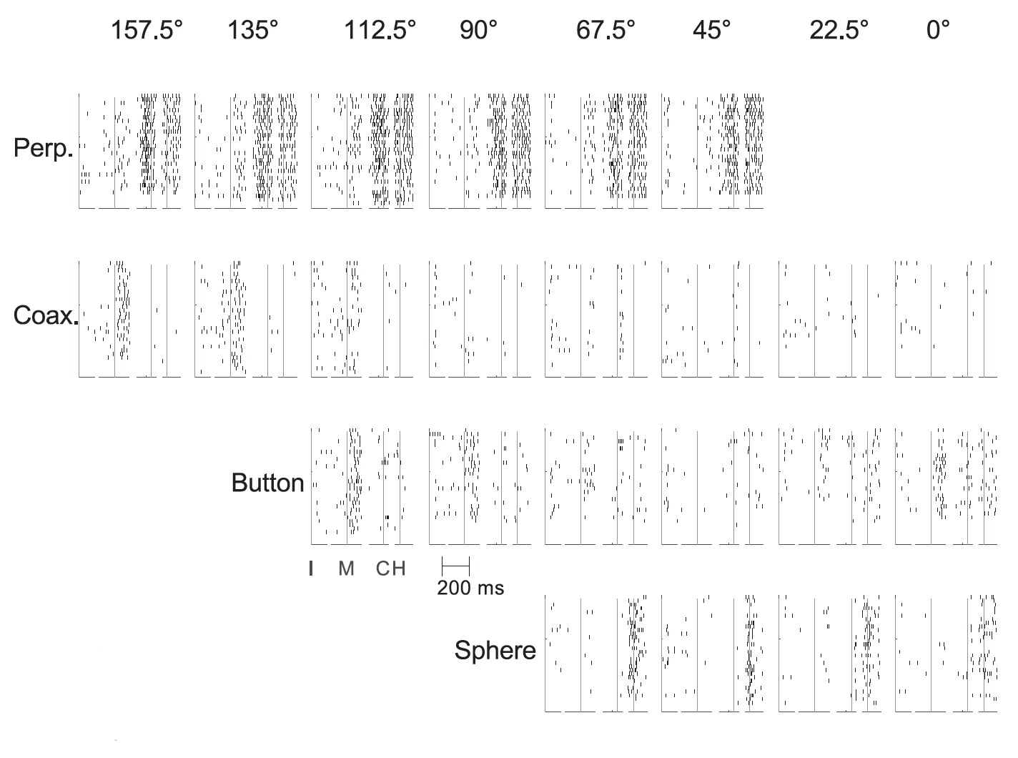
Typical neuron: mixed object-location effects
Locations
Objects
Rouse & Schieber 2016 J Neurosci.

Slide 23
Typical neuron: mixed object-location effects
Locations
Objects
Rouse & Schieber 2016 J Neurosci.

Slide 24
Typical neuron: mixed object-location effects
Locations
Objects
Rouse & Schieber 2016 J Neurosci.

Slide 25
Most neurons have mixed “tuning”
Rouse & Schieber 2018 Cell Reports
Notes:
Assessed using ANOVA
Time component of the data is bundled into “location” and “object”, as both effects are assumed to vary over time

Slide 26
Variance Partitioning
Initiation
Movement Start
First Contact
Beginning of Hold
No subtraction
No averaging
Rouse & Schieber 2018 Cell Reports
Notes:
The data ARE smoothed and square-root transformed
For most analyses, the baseline firing rates are subtracted on a neuron-by-neuron basis
Hierarchical model

Slide 27
Variance Partitioning
Initiation
Movement Start
First Contact
Beginning of Hold
General Task
No subtraction
No averaging
No subtraction
Average across:
Trials & Conditions
Rouse & Schieber 2018 Cell Reports
Notes:
The data ARE smoothed and square-root transformed
For most analyses, the baseline firing rates are subtracted on a neuron-by-neuron basis
Hierarchical model

Slide 28
Variance Partitioning
Initiation
Movement Start
First Contact
Beginning of Hold
General Task
Location / Object
No subtraction
No averaging
No subtraction
Average across:
Trials & Conditions
Subtract out:
GT
Average across:
Trials
Rouse & Schieber 2018 Cell Reports
Notes:
The data ARE smoothed and square-root transformed
For most analyses, the baseline firing rates are subtracted on a neuron-by-neuron basis
Hierarchical model

Slide 29
Variance Partitioning
Initiation
Movement Start
First Contact
Beginning of Hold
General Task
Location / Object
No subtraction
No averaging
No subtraction
Average across:
Trials & Conditions
Subtract out:
GT
Average across:
Trials
Subtract out:
GT & LO
No averaging
Rouse & Schieber 2018 Cell Reports
Notes:
The data ARE smoothed and square-root transformed
For most analyses, the baseline firing rates are subtracted on a neuron-by-neuron basis
Hierarchical model

Slide 30
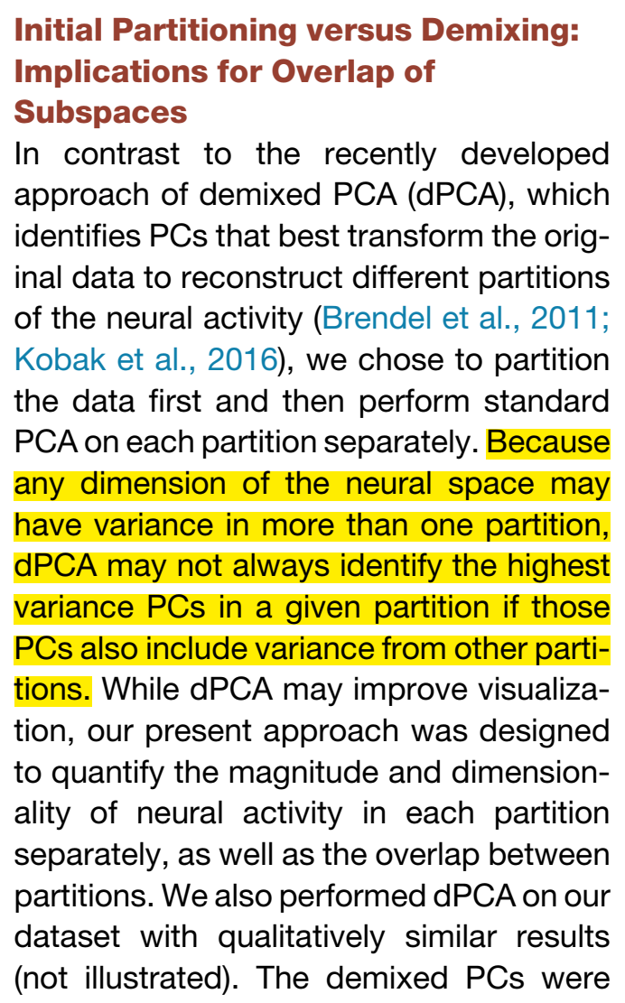
Variance Partitioning
Rouse & Schieber 2018 Cell Reports
Notes:
The data ARE smoothed and square-root transformed
For most analyses, the baseline firing rates are subtracted on a neuron-by-neuron basis
Hierarchical model

Slide 31
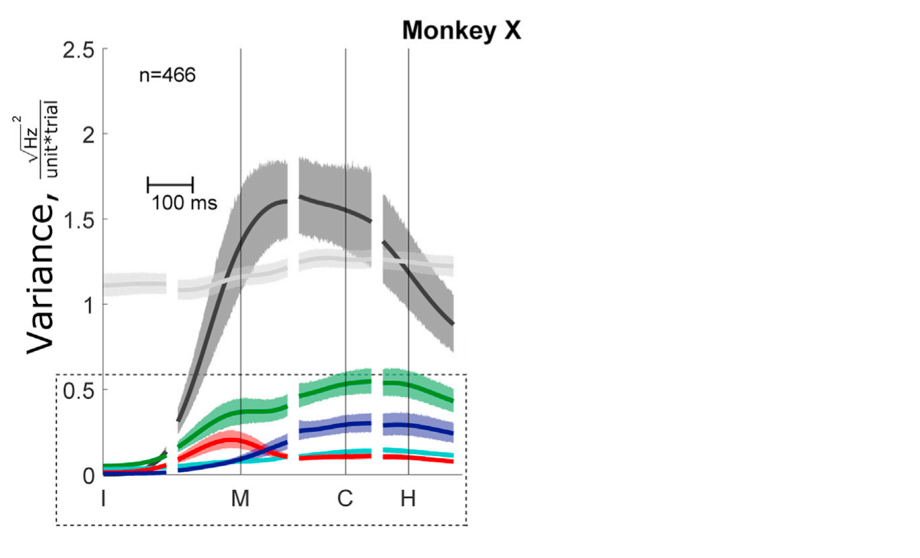
Variance of each component over time
Initiation
Movement Start
First Contact
Beginning of Hold
General Task
Location
Location / Object
Object
Noise
Interaction
Rouse & Schieber 2018 Cell Reports
Notes:
Shaded regions = 95% CI = Bootstrapped estimates (resampling with replacement) (further details of sampling not given)
Only showing this for one monkey, but both monkeys look similar

Slide 32
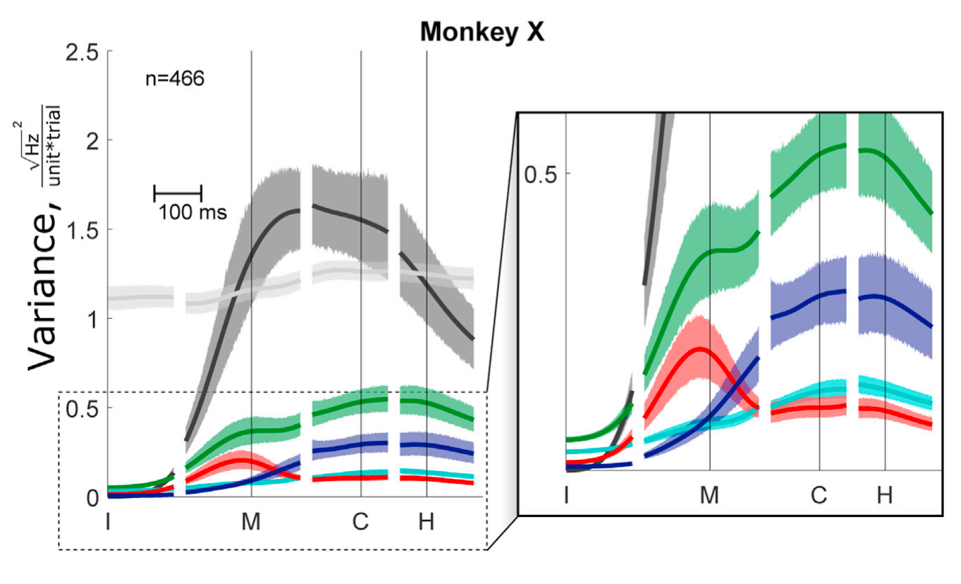
Variance of each component over time
Initiation
Movement Start
First Contact
Beginning of Hold
General Task
Location
Location / Object
Object
Noise
Interaction
Rouse & Schieber 2018 Cell Reports
Notes:
Shaded regions = 95% CI = Bootstrapped estimates (resampling with replacement) (further details of sampling not given)
Only showing this for one monkey, but both monkeys look similar

Slide 33
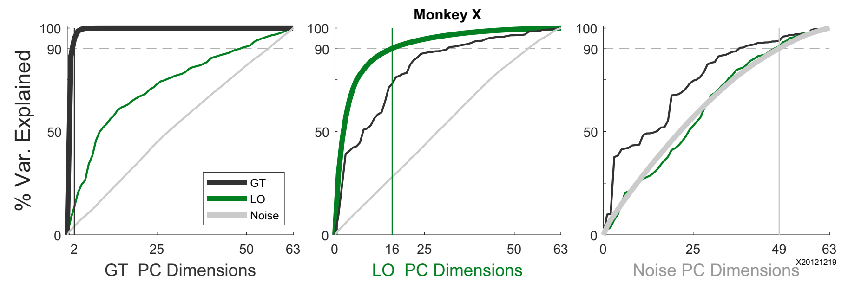
Overlap between subspaces
Rouse & Schieber 2018 Cell Reports

Slide 34
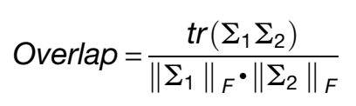
Overlap between subspaces quantified
Rouse & Schieber 2018 Cell Reports
Notes:
This metric spans 0-1

Slide 35
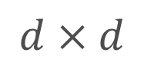
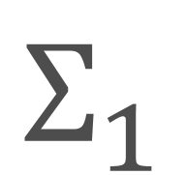
Overlap between subspaces quantified
Null distribution bootstrapping:
$$Σ_{1}$$
$$d×d$$
Rouse & Schieber 2018 Cell Reports

Slide 36
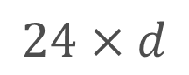
Overlap between subspaces quantified
Null distribution bootstrapping:
$$Σ_{1}$$
$$d×d$$
$$24×d$$
Rouse & Schieber 2018 Cell Reports

Slide 37

Overlap between subspaces quantified
Null distribution bootstrapping:
$$Σ_{1}$$
$$d×d$$
$$24×d$$
$$24×d$$
Rouse & Schieber 2018 Cell Reports

Slide 38
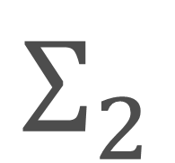
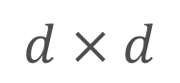
Overlap between subspaces quantified
Null distribution bootstrapping:
$$Σ_{1}$$
$$Σ_{2}$$
$$d×d$$
$$d×d$$
$$24×d$$
$$24×d$$
Rouse & Schieber 2018 Cell Reports

Slide 39
Overlap between subspaces quantified
Data (95% CI of Null):
GT vs LO:
GT vs Noise:
LO vs Noise:
L: 0.26 (0.02 – 0.18)
X: 0.26 (0.02 – 0.20)
L: 0.18 (0.11 – 0.17)
X: 0.24 (0.15 – 0.21)
L: 0.29 (0.20 – 0.29)
X: 0.36 (0.26 – 0.33)
Rouse & Schieber 2018 Cell Reports

Slide 40
Overlap between subspaces quantified
Data (95% CI of Null):
GT vs LO:
GT vs Noise:
LO vs Noise:
L: 0.26 (0.02 – 0.18)
X: 0.26 (0.02 – 0.20)
L: 0.18 (0.11 – 0.17)
X: 0.24 (0.15 – 0.21)
L: 0.29 (0.20 – 0.29)
X: 0.36 (0.26 – 0.33)
Not 0!
Rouse & Schieber 2018 Cell Reports

Slide 41
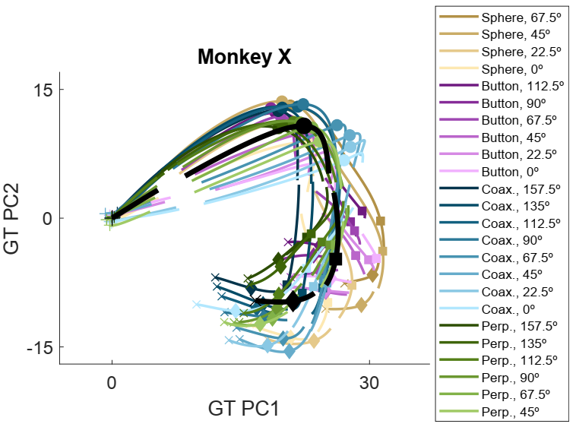
Projections onto GT subspace
Rouse & Schieber 2018 Cell Reports

Slide 42
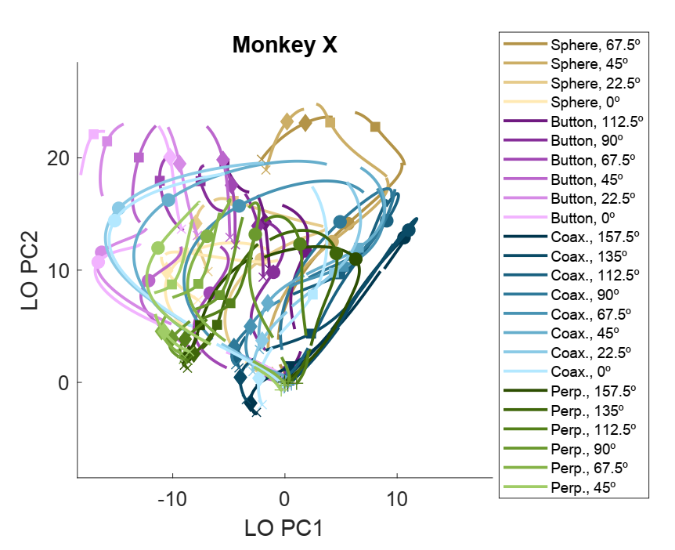
Projections onto LO subspace
Rouse & Schieber 2018 Cell Reports

Slide 43
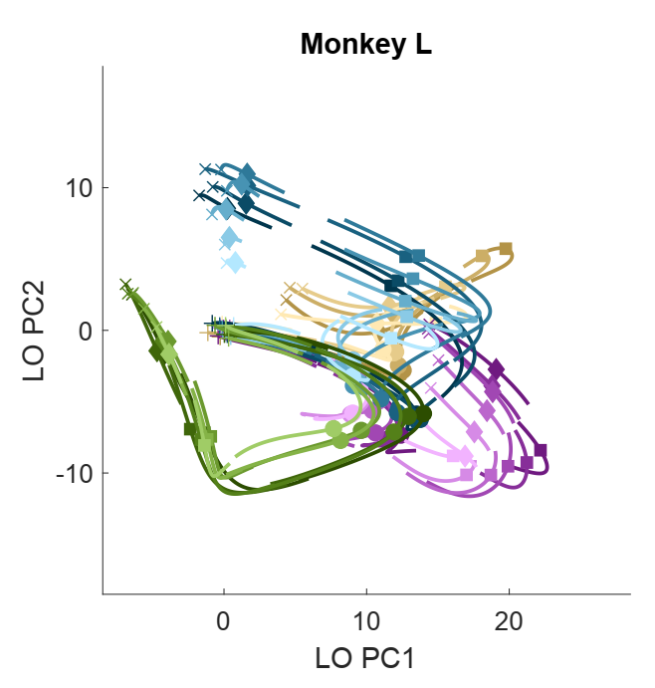
Projections onto LO subspace
Rouse & Schieber 2018 Cell Reports

Slide 44
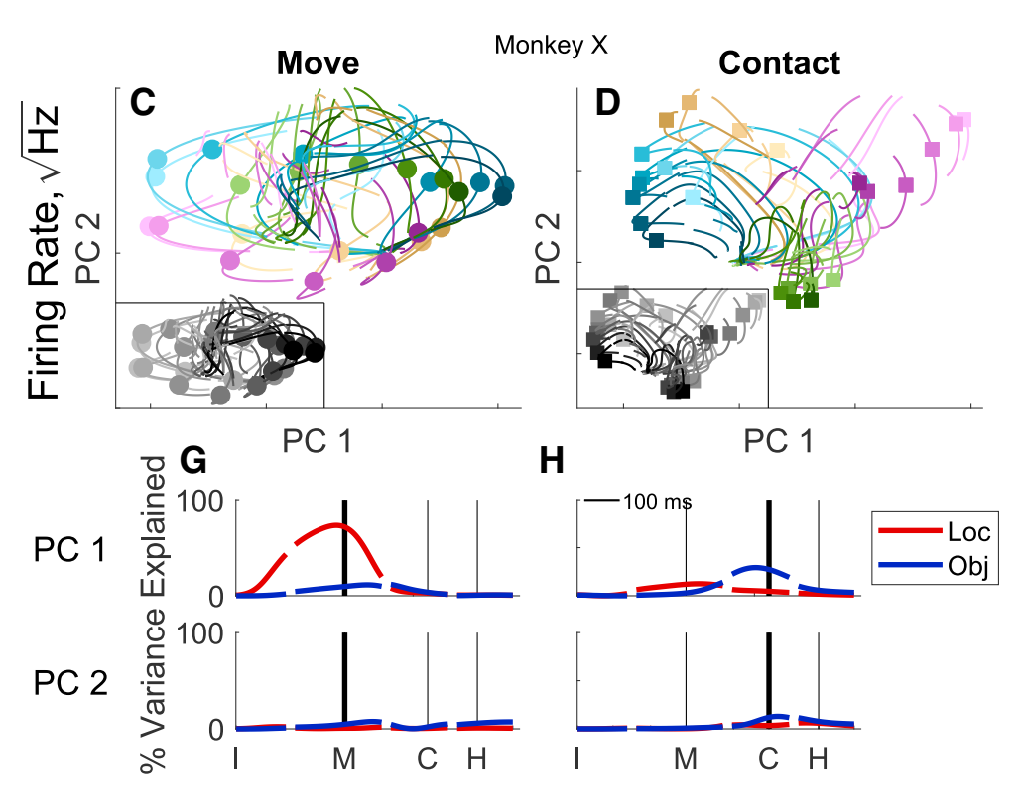
Separate PCA for different alignments
Rouse & Schieber 2018 Cell Reports

Slide 45
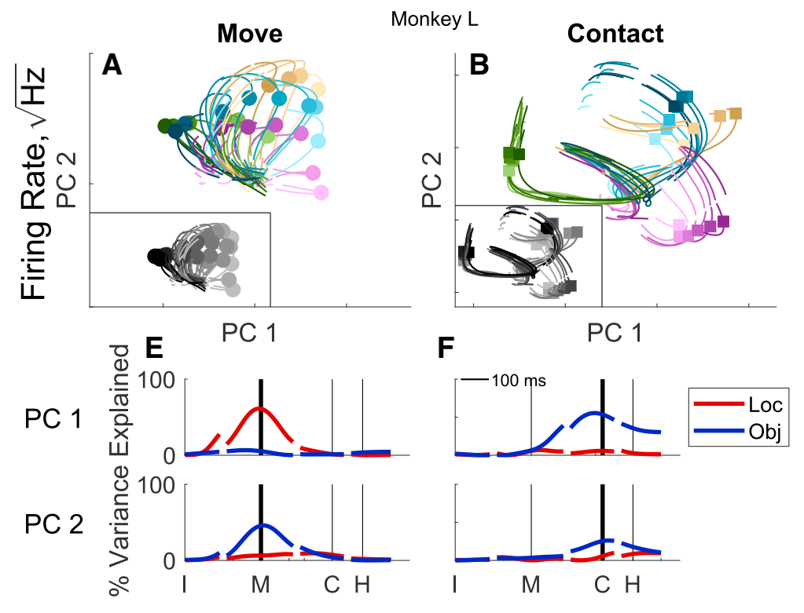
Separate PCA for different alignments
Rouse & Schieber 2018 Cell Reports

Slide 46
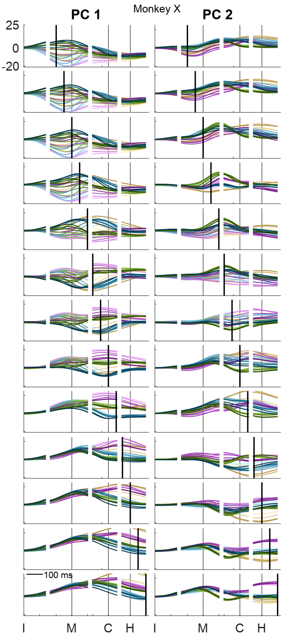
Even more time-specific PCA!
Rouse & Schieber 2018 Cell Reports

Slide 47
Even more time-specific PCA!
Rouse & Schieber 2018 Cell Reports

Slide 48
Even more time-specific PCA!
Rouse & Schieber 2018 Cell Reports

Slide 49
Even more time-specific PCA!
Rouse & Schieber 2018 Cell Reports

Slide 50
Even more time-specific PCA!
Rouse & Schieber 2018 Cell Reports

Slide 51
Even more time-specific PCA!
Rouse & Schieber 2018 Cell Reports

Slide 52
Even more time-specific PCA!
Rouse & Schieber 2018 Cell Reports

Slide 53
Even more time-specific PCA!
Rouse & Schieber 2018 Cell Reports

Slide 54
Even more time-specific PCA!
Rouse & Schieber 2018 Cell Reports

Slide 55
Even more time-specific PCA!
Rouse & Schieber 2018 Cell Reports

Slide 56
Even more time-specific PCA!
Rouse & Schieber 2018 Cell Reports

Slide 57
Even more time-specific PCA!
Rouse & Schieber 2018 Cell Reports

Slide 58
Even more time-specific PCA!
Rouse & Schieber 2018 Cell Reports

Slide 59
Overlap between time-specific PCAs
Rouse & Schieber 2018 Cell Reports

Slide 60
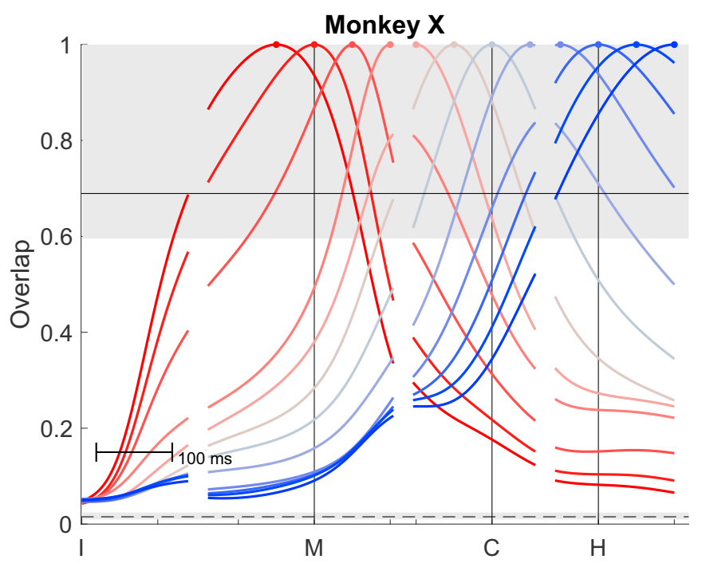
Overlap between time-specific PCAs
Rouse & Schieber 2018 Cell Reports

Slide 61
Overlap between time-specific PCAs
95% CI if sampled from same subspace
95% CI if sampled from shuffled subspaces
Rouse & Schieber 2018 Cell Reports

Slide 62
Conclusions

Slide 63
Conclusions
Mixed selectivity in individual M1 neurons

Slide 64
Conclusions
Mixed selectivity in individual M1 neurons
Separation of location & object only at the population level

Slide 65
Conclusions
Mixed selectivity in individual M1 neurons
Separation of location & object only at the population level
No spatial organization

Slide 66
Conclusions
Mixed selectivity in individual M1 neurons
Separation of location & object only at the population level
No spatial organization
Separation != orthogonal

Slide 67
Conclusions
Mixed selectivity in individual M1 neurons
Separation of location & object only at the population level
No spatial organization
Separation != orthogonal
Over time, neural activity gradually transitions

Slide 68
Conclusions
Mixed selectivity in individual M1 neurons
Separation of location & object only at the population level
No spatial organization
Separation != orthogonal
Over time, neural activity gradually transitions
From location-specific (“reach”) subspace

Slide 69
Conclusions
Mixed selectivity in individual M1 neurons
Separation of location & object only at the population level
No spatial organization
Separation != orthogonal
Over time, neural activity gradually transitions
From location-specific (“reach”) subspace
To object-specific (“grasp & manipulate”) subspace

Slide 70
Epilogue
Whence comes this transition?

Slide 71
Rotational dynamics?
Single rotational plane during reaching
Rouse & Schieber 2018 Cell Reports

Slide 72
Rotational dynamics?
Single rotational plane during reaching
Captures gradual transition from preparation to movement
Rouse & Schieber 2018 Cell Reports

Slide 73
Rotational dynamics?
Single rotational plane during reaching
Captures gradual transition from preparation to movement
Applies across multiple reaching contexts
Rouse & Schieber 2018 Cell Reports

Slide 74
Rotational dynamics?
Single rotational plane during reaching
Captures gradual transition from preparation to movement
Applies across multiple reaching contexts
Can this also account for transition from reach to grasp?
Rouse & Schieber 2018 Cell Reports

Slide 75
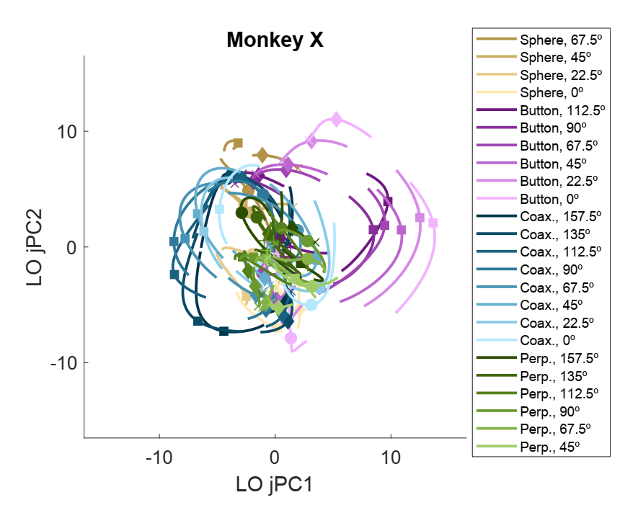
Rotational dynamics?
Rouse & Schieber 2018 Cell Reports

Slide 76
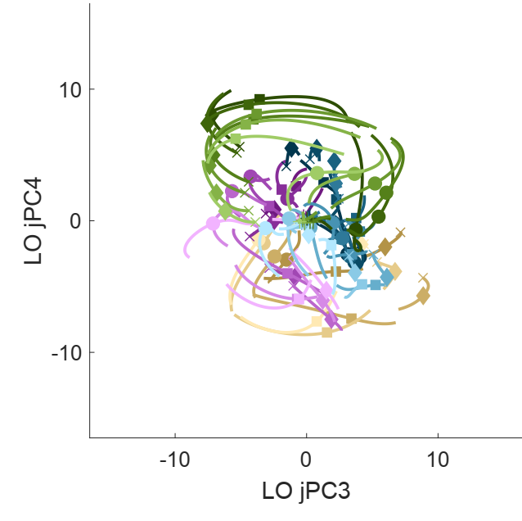
Rotational dynamics?
Rouse & Schieber 2018 Cell Reports

Slide 77
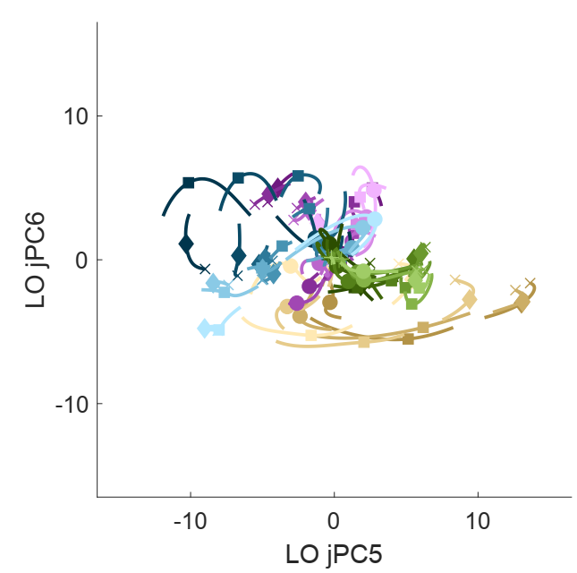
Rotational dynamics?
Rouse & Schieber 2018 Cell Reports

Slide 78
Rotational dynamics?
Single rotational plane during reaching
Captures gradual transition from preparation to movement
Applies across multiple reaching contexts
Can this also account for transition from reach to grasp?
Rouse & Schieber 2018 Cell Reports

Slide 79
Rotational dynamics?
Single rotational plane during reaching
Captures gradual transition from preparation to movement
Applies across multiple reaching contexts
Can this also account for transition from reach to grasp?
No: one plane cannot explain it all
Rouse & Schieber 2018 Cell Reports

Slide 80
Rotational dynamics?
Single rotational plane during reaching
Captures gradual transition from preparation to movement
Applies across multiple reaching contexts
Can this also account for transition from reach to grasp?
No: one plane cannot explain it all
Rotations occupy different dimensions depending on the object
Rouse & Schieber 2018 Cell Reports

Slide 81
FIN

